Slide 1

Analysis of Chicago Crimes Dataset
Product Overview Presentation
CSC 6740
Team 8

Slide 2
Team Members
Dhruv Gupta
Hsiu-Yuan Fan
Shinjini Srivastava

Slide 3
Presentation Overview
Project Overview
Introduction to Dispatching
Introduction to Scheduling
Scheduling in On Disc
Issues Identified
Proposed Approach

Slide 4
Project Overview
Analyze the Chicago Crimes dataset and find correlations in the elements that can be used for predicting crime

Slide 5
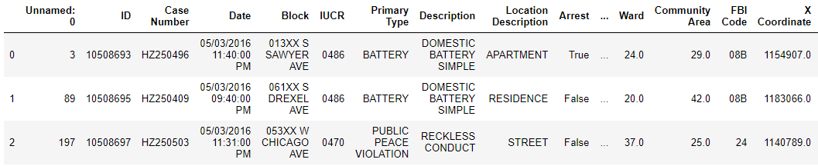
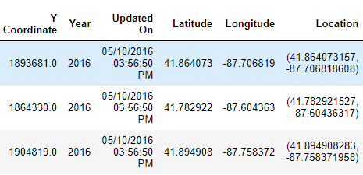
Data Set Snapshot: Crimes from 2012 to 2017

Slide 6
Data Cleaning
Identify Null values
Repeating Values
Highly Correlated Columns
Consistent Data Types

Slide 7
Null Values
Unnamed: 0 0
ID 0
Case Number 1
Date 0
Block 0
IUCR 0
Primary Type 0
Description 0
Location Description 1658
Arrest 0
Domestic 0
Beat 0
District 1
Ward 14
Community Area 40
FBI Code 0
X Coordinate 37083
Y Coordinate 37083
Year 0
Updated On 0
Latitude 37083
Longitude 37083
Location 37083
dtype: int64
Columns Dropped:
Unnamed
ID
Case Number
Location
X-coordinate
Y-Coordinate
Imputation
Location information is inferred from just longitude and latitude
Significant missing location information replaced by the mean of long / lat of Ward

Slide 8
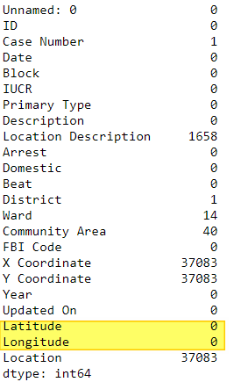
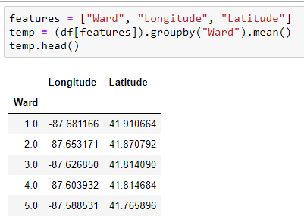

Imputation: Long / Lat
Calculate the mean Long / Lat for each ward
Build lookup table
For each missing Long Lat, look up the ward and replace the missing value with the value in look up table
Notes:
There were no fields with both missing Ward information and missing Long - Lat

Slide 9
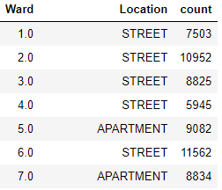
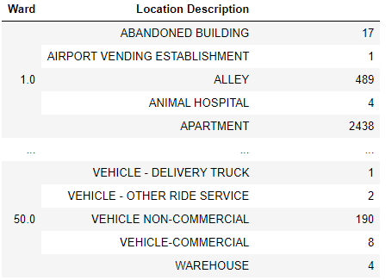
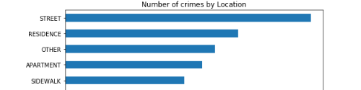
Imputation: Location Description
For each ward, the most occurring community area is calculated and kept in a table
For each entry with a missing community area:
Lookup the table with the ward as key and replace missing value
Notes:
This is important because otherwise all the replacements will be

Slide 10
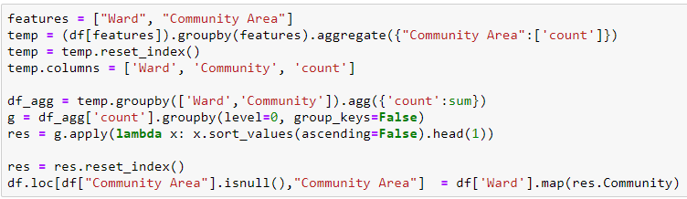
Imputation: Community Area
For each ward, the most occurring community area is calculated and kept in a table
For each entry with a missing community area:
Lookup the table with the ward as key and replace missing value
Other Imputed Columns: District

Slide 11
Exploratory Data Analysis
Rate of change of type of crime with respect to time over 5 year period
Change in # of crimes of a particular type wrt time of year
Are there more crimes in the Winter vs Summer ?
Change in the # of crimes with respect to the day of the week
Are there more crimes on the weekend ?

Slide 12
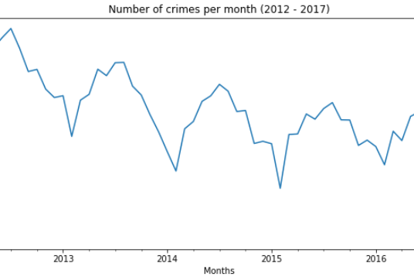
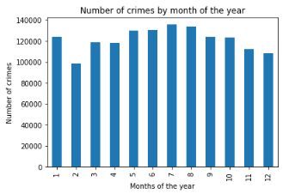
Crime is Cyclical: Lower during winter

Slide 13
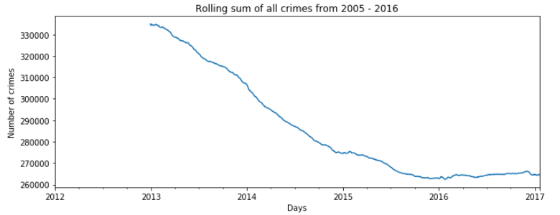
Falling Crime Rate

Slide 14
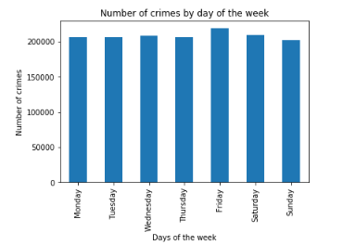
Crime doesn’t take a holiday: Crimes are independent of the day of the week

Slide 15
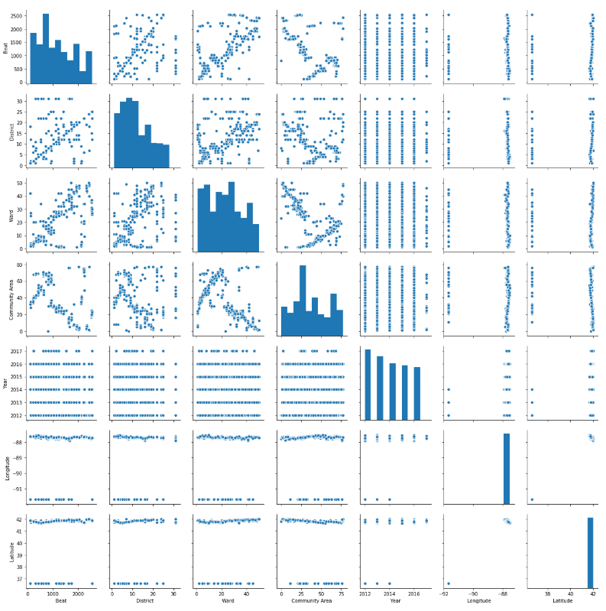
Checking correlations between columns

Slide 16
Algorithms Used
Principal Component Analysis
K means clustering
Naïve Bayes
Random Forrest

Slide 17
Principle Component Analysis
Principal components analysis (PCA) is one of a family of techniques for taking high-dimensional data, and using the dependencies between the variables to represent it in a more tractable, lower-dimensional form, without losing too much information.
Each principle component is a curve fitted to the data of all the features being reduced
Each PC represents the % of total variance of the model and reduces with each new PC

Slide 18
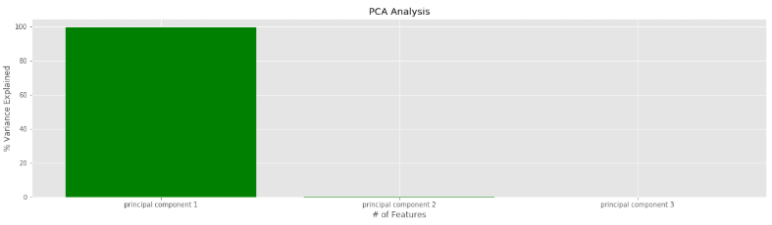
Principle Component Analysis
Variance: [9.95648109e-01 3.32653489e-03 7.50670815e-04]

Slide 19
K means Clustering
Clustering is an unsupervised learning technique
Partitional Clustering
Insight about the internal structure of the data
Examine partitioning between different groups
Useful for knowledge discovery

Slide 20
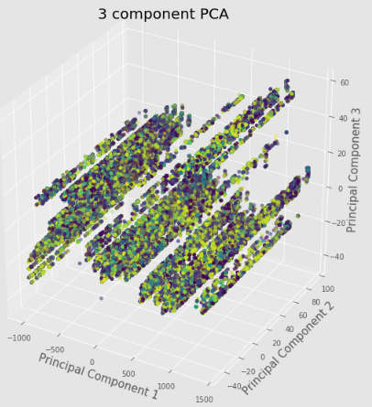
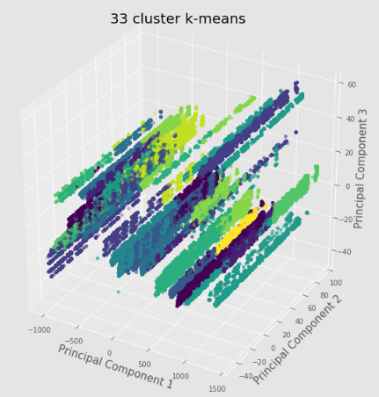
K means clustering

Slide 21
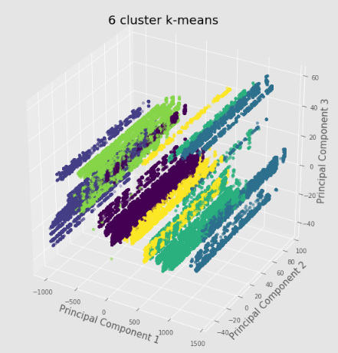
@ Fan … do you want to use this ?
Notes:
6 group clusters if you want to use that

Slide 22
Naïve Bayes: How does it work
\

Slide 23
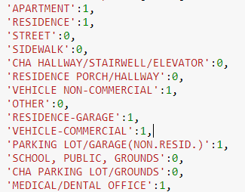
Input Encoding
Location information in encoded into indoor / outdoor

Slide 24
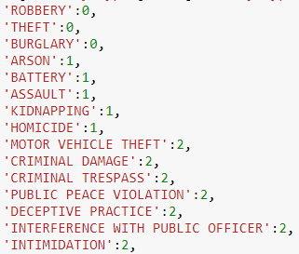
Output Encoding
Output labels are assigned to groups based on the type of crime

Slide 25
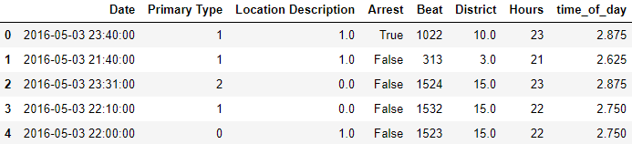
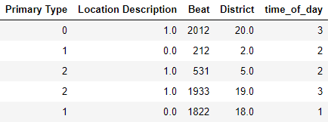
Naïve Bayes Preprocessing

Slide 26
Reciever Operating Charecteristic Curve (ROC)
Usefull when predicting probability of a binary outcome.
ROC Curves summarize the trade-off between the true positive rate and false positive rate for a predictive model using different probability thresholds.
ROC curves are appropriate when the observations are balanced between each class, whereas precision-recall curves are appropriate for imbalanced datasets.

Slide 27
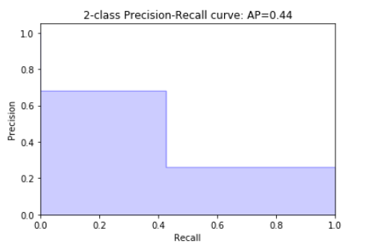
Naïve Bayes Results
Accuracy: 0.7987
Precision: 0.678
Recall: 0.427
Sensitivity: 0.427
Specificity: 0.861

Slide 28
Random Forest
Random Forrest is an ensemble learner which can be used for Classification and Regression.
Ensemble learners are composite ML tools which use multiple different learners in combination
Random Forest is composed of multiple decision trees
Each tree in the Forest is built from a different combination of columns
Finally for classifying data, each new data element runs through each tree and the mode of results from all trees is returned => Bagging [Bootstrap Aggregation]

Slide 29
Decision Tree
Learning the simplest decision tree is an NP complete problem
Greedy Heuristics must therefore be used to build a decision tree
Start with empty tree
Choose best feature to split tree
Recurse
Best feature for split
Good split increases certainty about classification after split = Reduces Entropy
Information Gain = Entropy before split – Entropy after split
Tree Building Summary
If output values are all same in the dataset, return leaf node
If all inputs are same, return leaf node that predicts the majority of the output
Otherwise find attribute with max information gain

Slide 30
Random Forrest Accuracy
# of folds | Accuracy
3 | 0.965700934
4 | 0.967702962
5 | 0.96951049
6 | 0.970040898
7 | 0.970358613
8 | 0.970568539
9 | 0.970443172
10 | 0.970755205
11 | 0.970612229
12 | 0.970671393
13 | 0.970797452
14 | 0.970910198
Measuring accuracy with k fold means and 20 trees

Slide 31
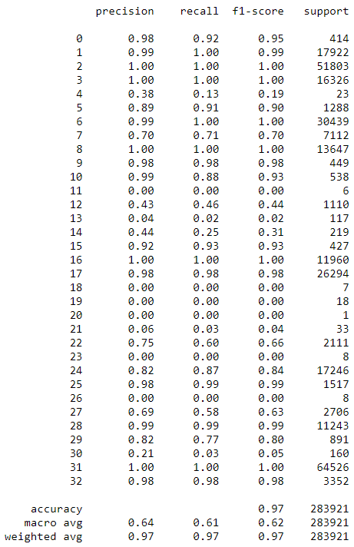
Random Forest Results

Slide 32
Performance Comparison
Classifier | Accuracy
Naïve Bayes | 79 %
Random Forrest | >95 %

Slide 33
Conclusion
It is possible to see predict what type of crime will occur based on an input vector with location information
From Data Visualizations, Police can see the trend of each crime in the city
Based on visualization, Police can decide how to respond to crime, e.g. Increase patrols in areas where large amount of street crime

Slide 34
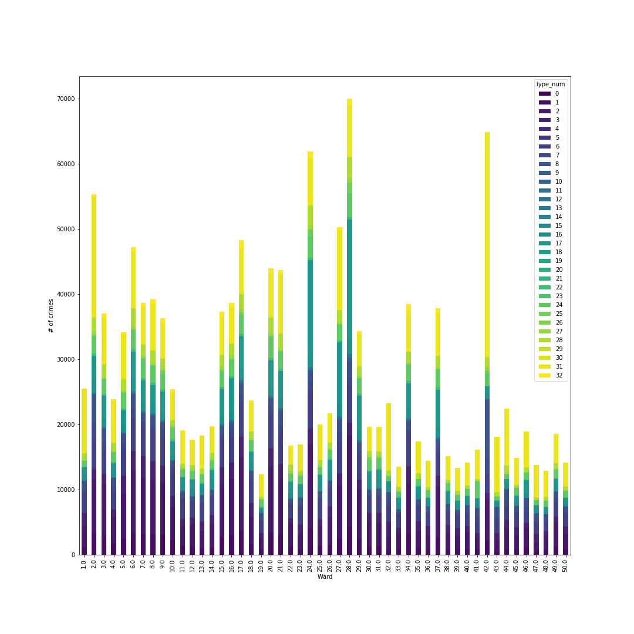
Crime Type distribution per Ward

Slide 35
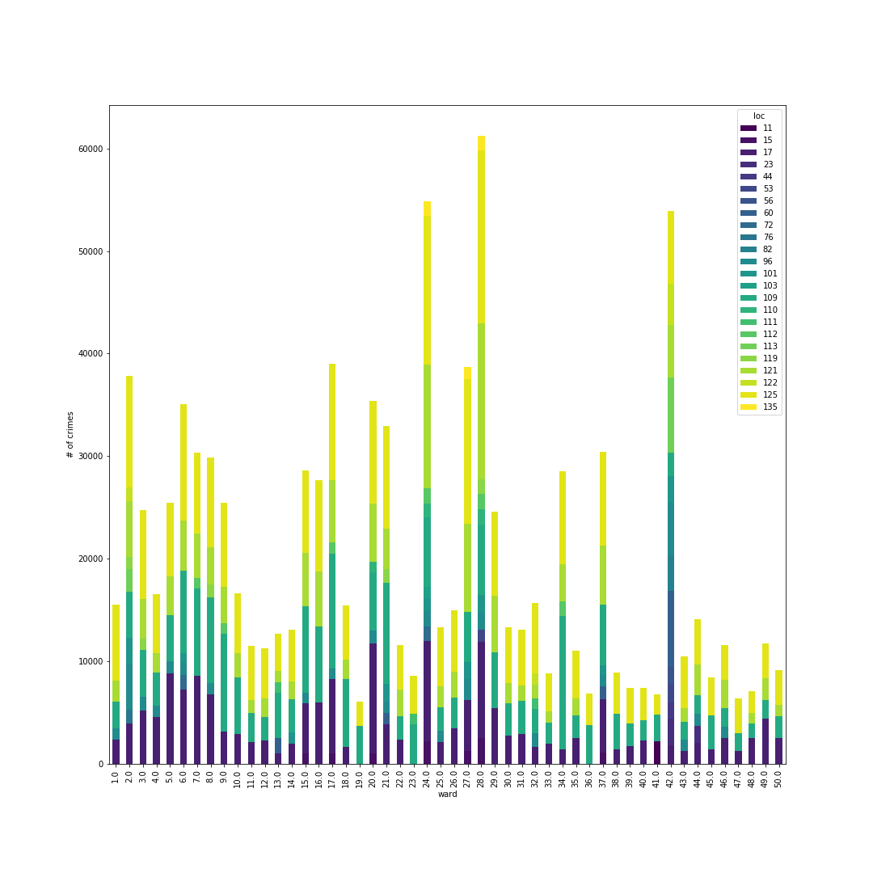
Significant Crime Location Distribution

